Slide 1
Python IDEs
Where and how to run python program

Slide 2
Plan for today
Installing python 3.7
Installing PyCharm IDE
Instaling Jupyter notebook
Getting familiar with command line

Slide 3
Download links
PyCharm 2020.2
https://www.jetbrains.com/pycharm/download/#section=windows
Python 3.7
https://www.python.org/downloads/release/python-370/

Slide 4
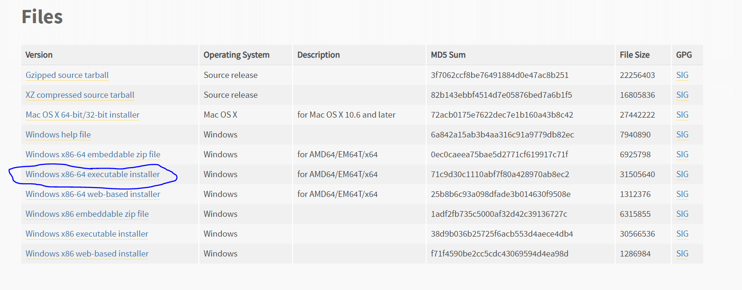
Python download

Slide 5
Command line
On Mac it is called terminal
It is file management system
Whatever you can do with your mouse, you can do with command line

Slide 6
Command line
Every file on PC has path, which uniquely describes it
Meaning that using path we can do everything what we can perform using mouse
open, close, delete, rename, move

Slide 7
File path
Root directory
Why is directory important?
We can open files from current directory by calling just its name
We can open file from other directory, but its path should be specified
Types of file path:
Absolute
Relative

Slide 8
File path
Absolute file path tells us where particular file is located relative to root directory
Relative file path tells us where particular file is located relative to some other directory

Slide 9
File path
What is system path?
Programs stored in folders that are in system path, can be opened by simply calling their names regardless of folder (file path) we are currently located in !!!
All files stored in system pathS must have unique name !!!

Slide 10
Command line
What is necessary to run file on command line?
What we need to specify?
Using which program we want to open specific file.
What specific file we want to open.

Slide 11
Command line
What activities we can perform on cmd/terminal?
What is workflow?
Traveling from one place to another (from one folder to another)
Opening files from some specific place
Renaming, deleting, moving files

Slide 12
Command line
Basic commands on Mac
pwd present working directory
ls list files from present working directory
cd change directory
cp copy
mv move
cd .. go one folder back

Slide 13
Command line
Basic commands on Windows
cd present working directory
dir list files from present working directory
cd change directory
copy copy
move move
cd .. go one folder back

Slide 14
Command line
Be very careful !
On command line, you can really make a mess
It is just one command from totally destroying PC

Slide 15
Command line
Example
Create txt file on desktop
Open it using notepad
Type on cmd ‘notepad filepath’

Slide 16
Different ways to run python
Command line / terminal
Using IDEs
Using jupyter

Slide 17
Terminal/command line
Simplest way to run commands
Just open terminal and type ‘python’
It will work if you included python in system path
No support in writing code

Slide 18
What is good developer?
Someone who knows all syntax by heart, or
Someone who perfectly knows building blocks and know how to combine different elements into useful and meaningful unit/module.
(Some elements of creativity is required).

Slide 19
Modern IDEs
An IDE is as important for developer as a calculator for a mathematician.

Slide 20
Why to use modern IDEs?
Autocomplete
Documentation
Syntax highlight and validation
Debugging
Refactoring
Code generation
VCS

Slide 21
Things I try to avoid
Learning syntax by heart
Learning over-specific and narrowly specialised functions and methods

Slide 22
IDE advantages
Give us opportunity to focus on important and general things.
Provide us with tools to query documentation fast.

Slide 23
IDE advantages
Release burden of learning language syntax by heart.
Give us possibility to choose from!

Slide 24
PyCharm and Jupiter
We are going to use both programs/editors
PyCharm is the best product in the market and for most of the tasks it is 5 places in front of its competition
Jupyter is becoming more and more popular

Slide 25
PyCharm and Jupiter
Also, jupyter is good for visualisation and presentations
But still, jupyter lacks most of intellisense features

Slide 26
Python installation
Pay attention at ‘include as system variable’. It should be checked.
Python should be in system variables.

Slide 27
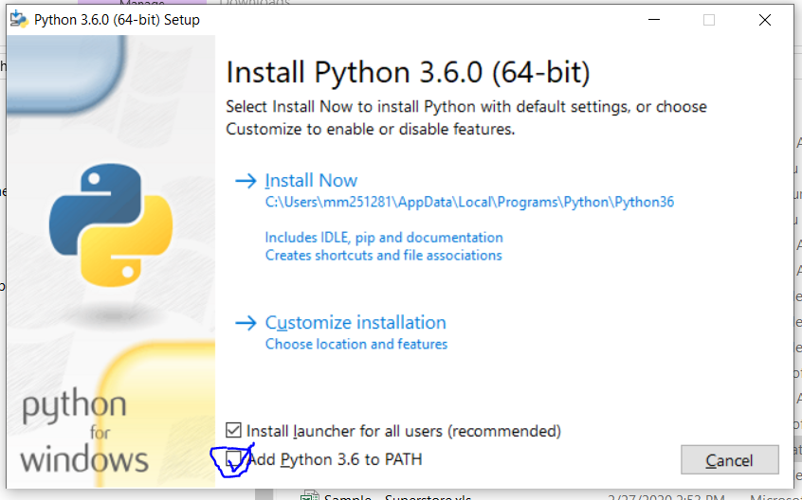
Python installation

Slide 28
PyCharm installation
Just follow the steps: ‘next, next…finish’
Doesn’t have to be included in system path variables

Slide 29
Jupiter installation
Open command line
Type: ‘pip install jupyter’

Slide 30
PyCharm elements
Editor
Console
Project window
Variable explorer

Slide 31
IDE’s advanced features
Quick documentation
Function/class implementation details
Parameter info
Find class/function by name i.e. auto import
Debugging
Version control

Slide 32
IDE’s standard features
Find and replace
Rename
Refactor code
Syntax highlight
Find usage

Slide 33
PyCharm shortcuts
Mac shortcuts
Shift + command + I
Option + J
Command + P
Control + space space
control+alt+t

Slide 34
PyCharm shortcuts
Windows shortcuts
Control + shift + I
Control + Q
Control + P
Control + space space
option+command+t

Slide 35
Jupiter shortcuts
command+tab
command+tab-tab

Slide 36
My suggestion
Don’t be afraid of making mistakes.
Python errors are going to become your second nature.
Google is going to be your best friend.

Slide 37
Other tools available in market
VScode
Eclipse
Visual studio
Xcode
Jupyter lab

Slide 38
Extra tip
How to see what libraries you have installed?
Command: pip list

Slide 39
Topic for next class
Storing data into variables.

Slide 40
The end
Thank you for your most valuable resource, your time.

